Slide 1

Real-Time Lexical Analyzer For A Subset Of C Programming Language
A Compiler Design Mini Project
Presented by: Somil, Pratham, Khushi, Dikshant
Under the guidance of: Dr. Neeraj Kumar Pandey

Slide 2
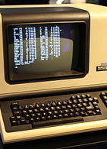
Objective
The objective of the project includes:
Develop a real-time lexical analyzer that scans C code as it is typed.
Identify and categorize lexical tokens such as keywords, identifiers, operators, literals, and symbols.
Provide instant feedback on invalid tokens or lexical errors.
Create an interactive, editor-like interface using web technologies for ease of use.
Aid in the understanding of lexical analysis in the compilation process through visualization and hands-on interaction.
This Photo by Unknown Author is licensed under CC BY-SA

Slide 3

Technology Stack
This project leverages a combination of web technologies and compiler concepts to simulate a real-time lexical analyzer directly in the browser. The frontend provides an editor-like interface while the lexical logic is implemented in JavaScript to identify and categorize tokens efficiently
Frontend:
HTML5: Structures the layout of the web page.
CSS3 / Tailwind CSS: Handles styling and responsive design.
React.js: Component-based structure for a dynamic and responsive UI.
Monaco Editor: Integrated code editor component for real-time input
Lexical Analyzer Logic:
Written in JavaScript using Regular Expressions (Regex).
Detects tokens as keywords, identifiers, literals, operators, and symbols.
Provides instant error messages for unrecognized tokens.
Development Tools:
Visual Studio Code (VS Code) for coding and debugging.
Git for version control and backup.

Slide 4

Project Idea/ Overview
The Real-Time Lexical Analyzer aims to simulate a part of the compilation process by analyzing C code as it's being written. By leveraging web technologies like React and JavaScript, this tool provides an interactive, hands-on environment to help users better understand lexical analysis.
The overview of the project is as follows:
The lexical analyzer scans the input text (C code) as the user types, breaking it down into tokens such as keywords, identifiers, operators, literals, and symbols.
As each token is detected, the system provides real-time feedback, highlighting errors or invalid tokens.
Users interact with a code editor-like interface that mimics real-world coding environments, making it intuitive and user-friendly.
Instant suggestions and error messages appear directly in the editor, allowing users to correct mistakes on the spot.

Slide 5
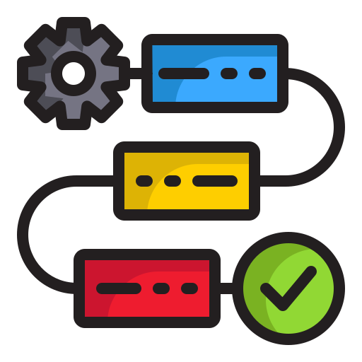
Workflow/ Architecture
The Real-Time Lexical Analyzer follows a streamlined workflow, providing users with immediate feedback as they type C code. The process is broken down into the following steps:
User Input: The user types C code into the Monaco Editor (embedded within the browser using React).
Tokenization: As the user types, a custom JavaScript lexical analyzer scans the input in real-time.
Token Categorization: The analyzer uses regular expressions (Regex) to categorize the code into tokens such as keywords, identifiers, literals, operators, and symbols.
Error Detection: If an invalid token is found, it is flagged immediately.
Instant Feedback: The interface provides real-time feedback, highlighting the errors and offering correction suggestions.

Slide 6

Roles & Responsibilities Of Each Member
Somil Negi – Team Lead & Front End Developer
Coordinate the overall project progress and timeline.
Lead the design and development of the React-based frontend interface.
Pratham Singh – UI Designer & Front End Developer
Design the user interface to ensure it’s clean, intuitive, and responsive.
Implement styling using Tailwind CSS for modern, responsive design.
Khushi – Tokenization Logic Developer
Develop the tokenization logic to break down C code into lexical tokens such as keywords, operators, etc.
Optimize the tokenization process to ensure real-time, error-free scanning of the code.
Dikshant Singh Chib – Quality Assurance & Testing
Test the tokenization logic to ensure it categorizes tokens correctly and flags errors as expected.
Conduct UI testing to verify that the real-time feedback system functions seamlessly.
Identify and report bugs for the team to address in a timely manner.

Slide 7

Thank You
We hope you enjoyed learning about our Real-Time Lexical Analyzer project!

